Slide 1

WELCOME TO MY PRESENTATION
MD.Rasel Hossain
ID:163432521

Slide 2
PRESENTATION TOPIC:
How is Computer Code Transformed into an Executable?

Slide 3
Computer Code Execute into 3 Different Method
Compilers
Interpreters
Hybrid systems

Slide 4
Language Implementation methods
Compilation – Programs translated into machine language code that is directly executable
Interpretation – Programs are interpreted by an "interpreter"
Hybrid Systems – A compromise between compilers and interpreters

Slide 5
Compiler Implementation
Compiler - program that
– Read a program written in one language (the source language)
– Translates it into an equivalent program in another language (the target language)

Slide 6
8 Phases of a Compiler
6 main phases
1. Lexical analyzer
2. Syntax analyzer
3. Semantic analyzer
4. Intermediate code generator
5. Code generator
6. Code optimizer
Two more activities (in parallel with 6 phases above)
A. Symbol table manager
B. Error handler

Slide 7
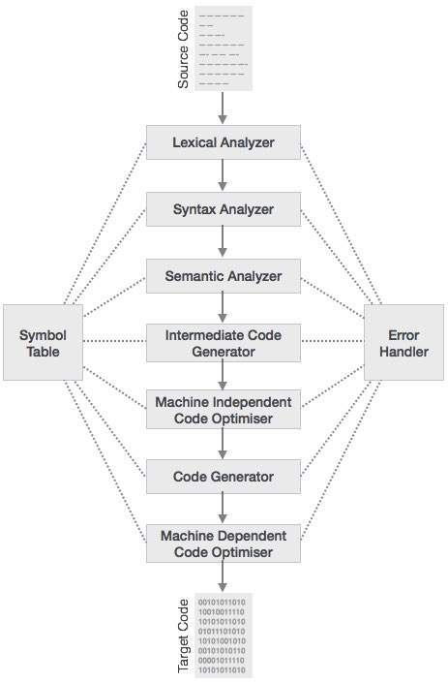

Slide 8
Symbol Table Manager
Uses a symbol table
Data structure (array, linked list, hash table, etc.)

Slide 9
Error Detection and Reporting
When an error is detected, then proceed to find more possible errors
– Lexical analysis phase detects errors
– Syntax analysis phase detects errors
– Semantic analysis phase detects errors

Slide 10
Implementation Methods
High-level language statements are immediately decoded into machine code & executed.
Source :https://slideplayer.com/

Slide 11


